Slide 1
Free Board
ECE 3710 FALL 2015
Thu Hoang, Max Hansen, Dusty Argyle, Reuben Fishback
Notes:
Introduction: Thu
Logic Design: Max
Memory/Testing: Reuben
Game: Thu
Peripherals: Dusty
Conclusion: Dusty

Slide 2
Overview
Introduction: Thu
Logic Design: Max
Memory and Testing: Reuben
Game: Thu
Peripherals: Dusty
Conclusion: Dusty

Slide 3
Logic Design
How we set up the processor
Tentative plan
Diagram

Slide 4
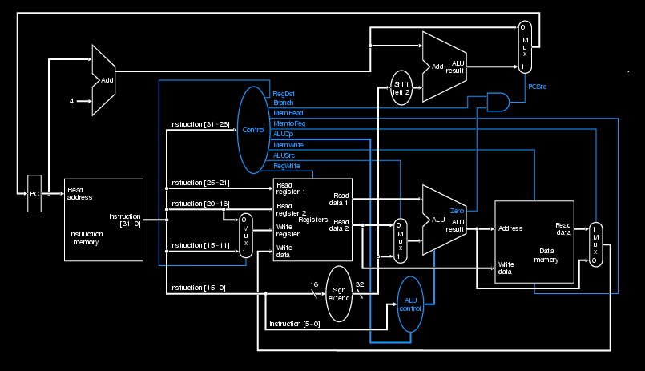
Logic Design

Slide 5
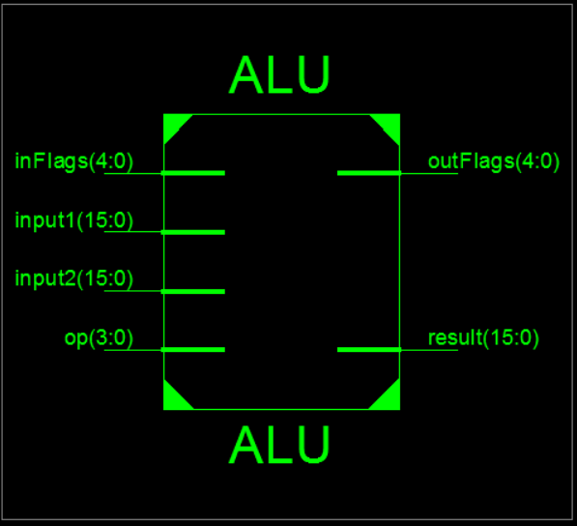
ALU
Basic operations
ADD, SUB, Logical
May add more instructions
Register to preserve flags

Slide 6
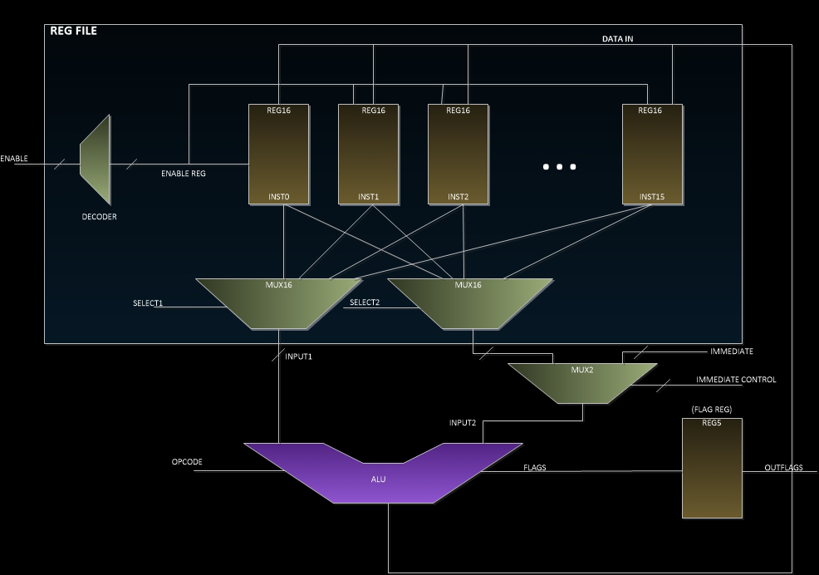
Register File
Standard design
Some reserved registers
Address register
Stack pointer
Maybe more

Slide 7
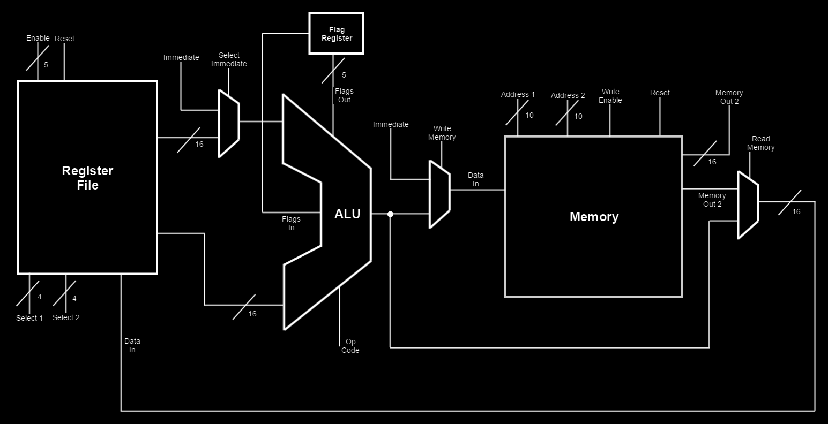
Current Diagram

Slide 8
Future Additions
Branching logic
Instruction controls
Instruction memory/state machine

Slide 9
Memory
Two portions of memory
Data
Peripherals
Data flow controlled using MUXs

Slide 10
Testing
Basic functionality
Corner cases
Fibonacci sequence with finite state machine

Slide 11
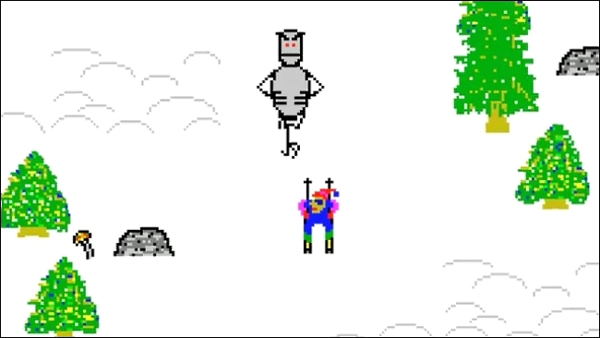
Free Boarding
3rd person perspective
Snowboarder glyph
Obstacles on trails
Points awarded by time
Levels
Increase in obstacles
New obstacles
“Ski Free Game”
Features: sounds on impact, menu and settings (if time allows)

Slide 12
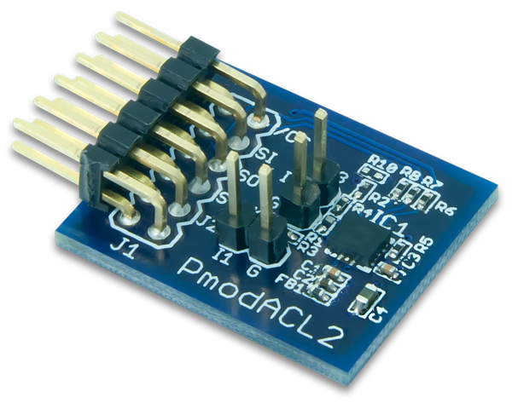
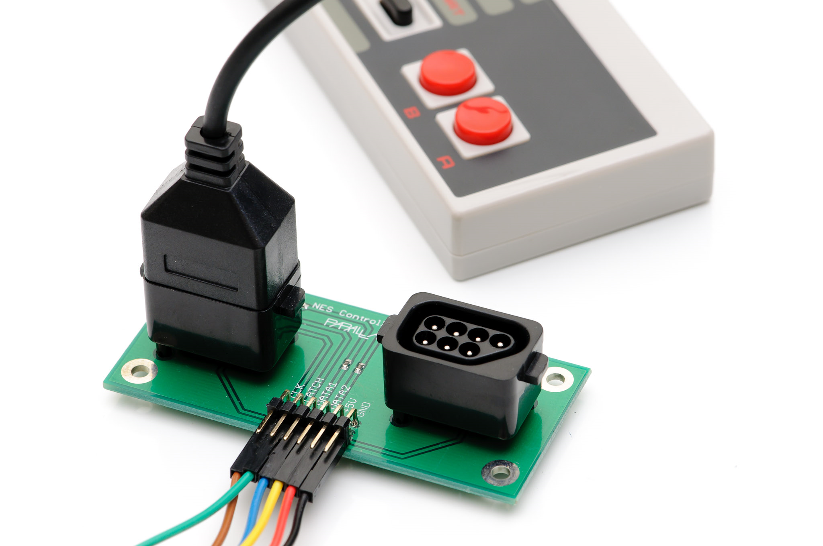
Peripherals (Controller)
Nintendo Controller
Provide an interface for moving the sprite
Inertial Measurement Unit (IMU)
Possibly using a device to measure leaning on a board
Possible Interfacing Techniques
Sampling
Direct memory access

Slide 13
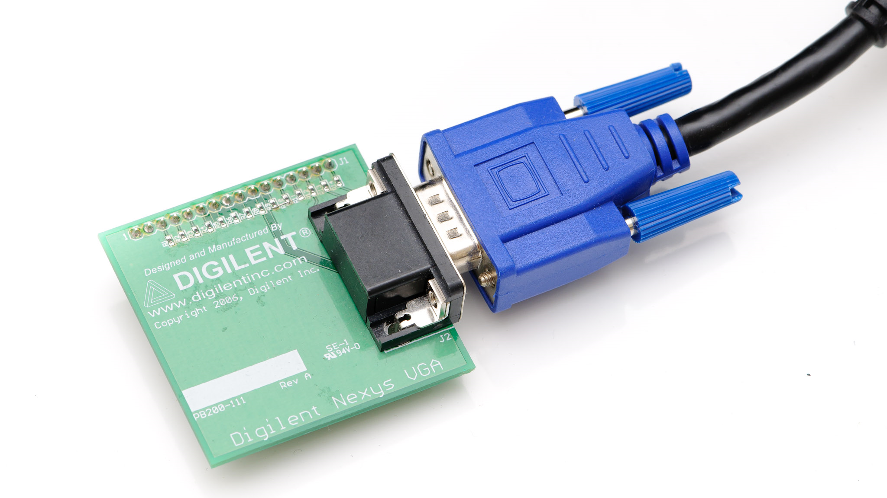
Peripherals (VGA)
Display
The sprite with the background and obstacles
Displayed at 100 MHz
8-Bit Color
Interfacing
Reading directly from memory on an independent port

Slide 14
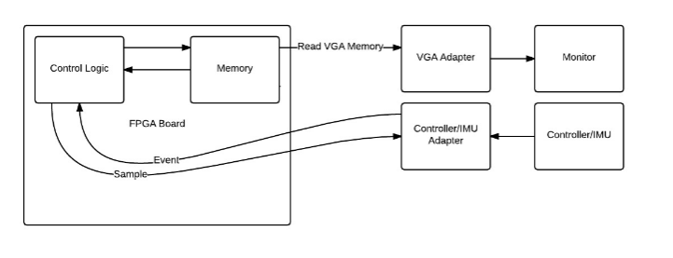
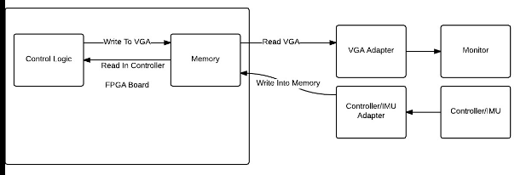
Peripheral Block Diagram

Slide 15
Conclusion
Logic Design
Free Board
Peripherals

Slide 16
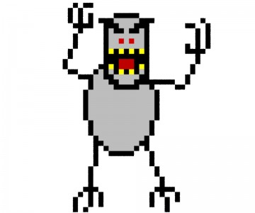
Questions?

Slide 17
Work Cited
http://glacierhub.org/wp-content/uploads/2014/07/sshot4f2ab791bcdb81.jpg
https://www.flickr.com/photos/danstrother/4870459837/in/photostream/

